Slide 1
The Secret of Academic Success

Slide 2
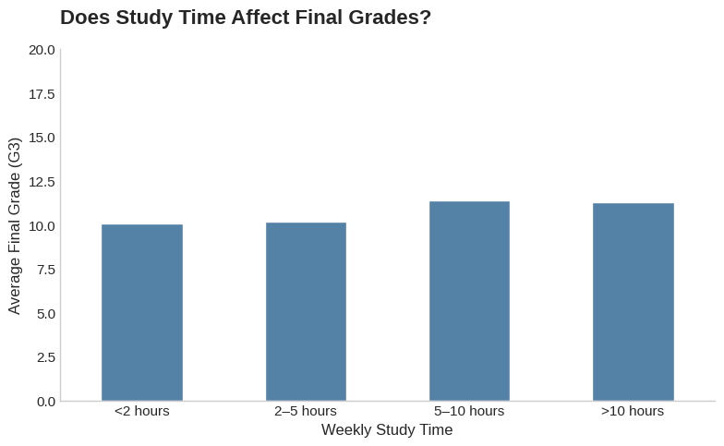
Is it The Study Time?

Slide 3
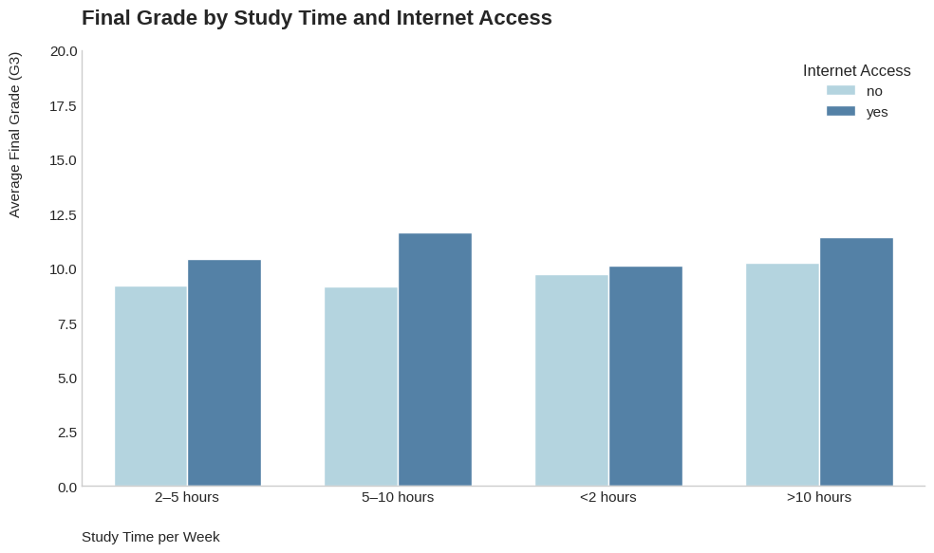
The Internet Effect

Slide 4
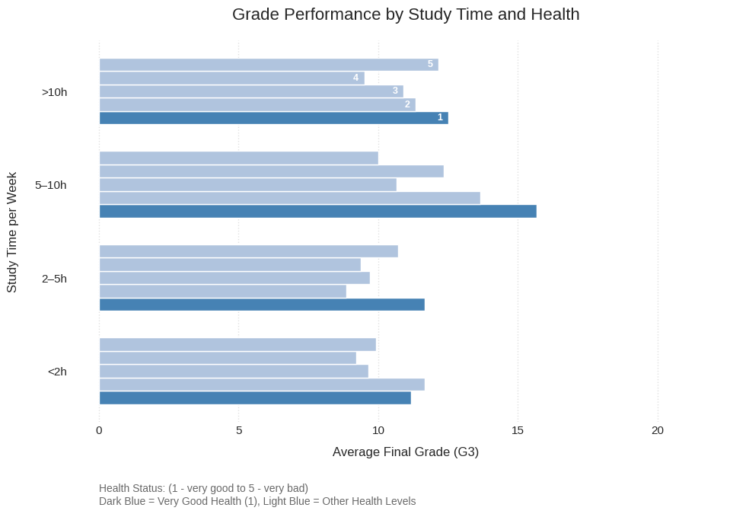
Healthy or not

Slide 5
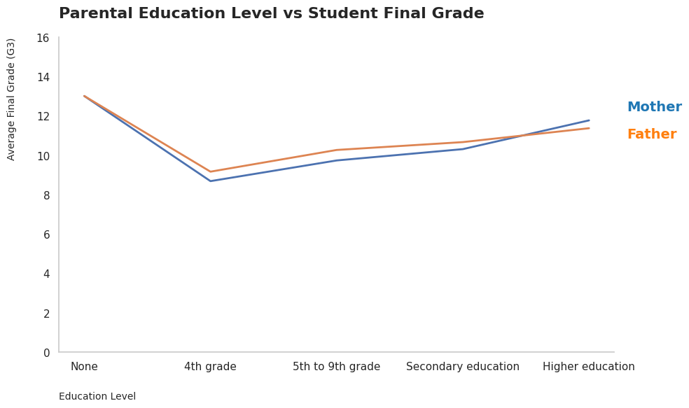
Educated Parents

Slide 6
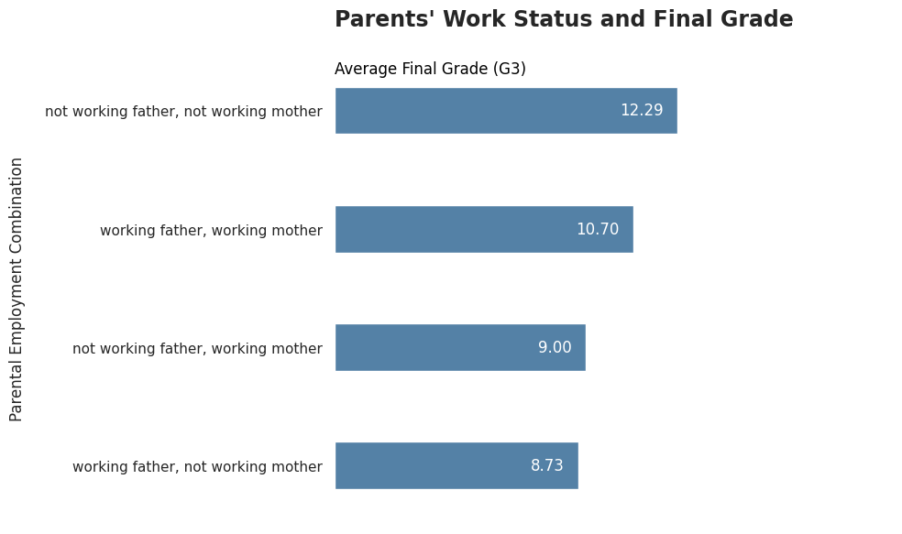
Are They Free?

Slide 7
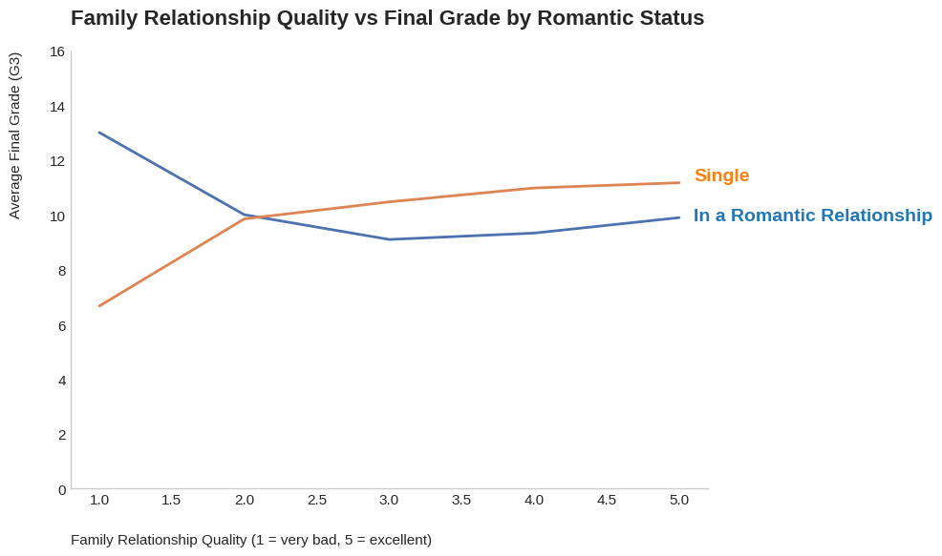
Romantic Relation Beats Family!

Slide 8
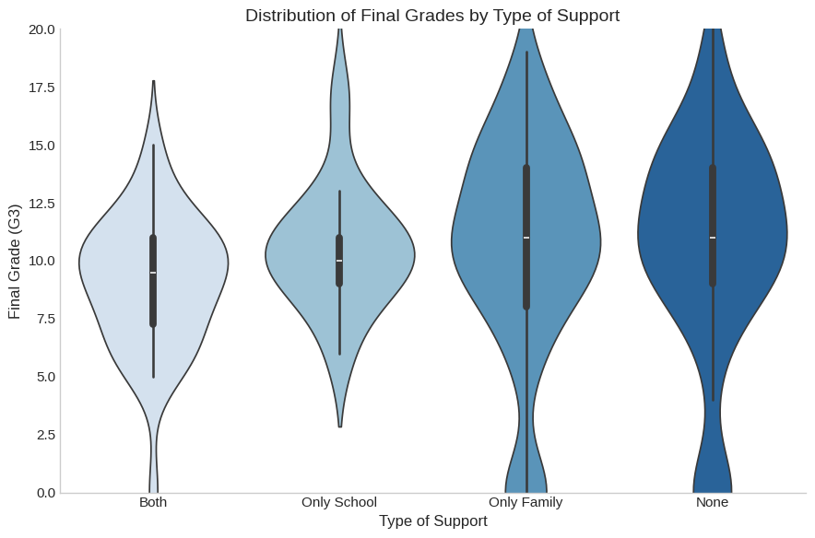
Educational Support

Slide 9
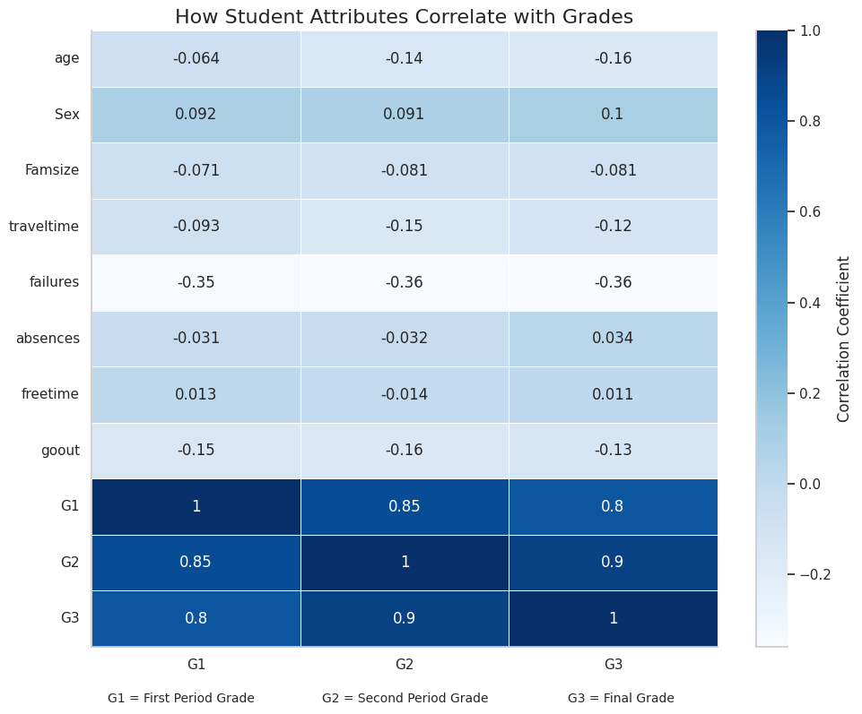
An Overview

Slide 10
Thank you

